Slide 1
A Closer Look at Methods

Slide 2

Overview
Passing objects as parameters
Effect of changes to object parameters Overloading
Overloaded method resolution Variable number of parameters

Slide 3


Passing Objects as Parameters
Passed “by reference”
Parameter receives a copy of the reference
Changes to the reference
Visible within method Not visible outside method

Slide 4
public class Flight {
private int flightNumber;
Flight.java
public Flight(int flightNumber) {
this.flightNumber = flightNumber;
}
// other members elided
}

Slide 5


val1
Main.java
flightNumber
10
Flight val1 = new Flight(10);
Flight val2 = new Flight(20);
val2
flightNumber
swapFlight(val1, val2);
20
static void swapFlight(Flight i, Flight j) {
Flight k = i; i = j;
j = k;
}
i
j

Slide 6
val1
Main.java
flightNumber
Flight val1 = new Flight(10);
Flight val2 = new Flight(20); swapFlight(val1, val2);
10
val2
flightNumber
20
// print flight #’s val1:10, val2:20
static void swapFlight(Flight i, Flight j) {
Flight k = i; i = j;
j = k;
}
k
i
j

Slide 7

Passing Objects as Parameters
Passed “by reference”
Parameter receives a copy of the reference
Changes to the reference
Visible within method Not visible outside method
Changes to members Visible within method Visible outside method

Slide 8
val1
Main.java
flightNumber
10
Flight val1 = new Flight(10);
Flight val2 = new Flight(20); swapNumbers(val1, val2);
val2
flightNumber
20
static void swapNumbers(Flight i, Flight j) {
int k = i.getFlightNumber(); i.setFlightNumber(j.getFlightNumber()); j.setFlightNumber(k);
}
i
j

Slide 9
val1
Main.java
flightNumber
10
Flight val1 = new Flight(10);
Flight val2 = new Flight(20); swapNumbers(val1, val2);
val2
flightNumber
20
static void swapNumbers(Flight i, Flight j) {
10
int k = i.getFlightNumber();
k
i.setFlightNumber(j.getFlightNumber());
j.setFlightNumber(k);
i
}
j

Slide 10
val1
Main.java
flightNumber
20
Flight val1 = new Flight(10);
Flight val2 = new Flight(20); swapNumbers(val1, val2);
val2
flightNumber
20
static void swapNumbers(Flight i, Flight j) {
10
int k = i.getFlightNumber();
k
i.setFlightNumber(j.getFlightNumber());
j.setFlightNumber(k);
i
}
j

Slide 11
val1
Main.java
flightNumber
20
Flight val1 = new Flight(10);
Flight val2 = new Flight(20); swapNumbers(val1, val2);
val2
flightNumber
10
static void swapNumbers(Flight i, Flight j) {
10
int k = i.getFlightNumber();
k
i.setFlightNumber(j.getFlightNumber());
j.setFlightNumber(k);
i
}
j

Slide 12
val1
Main.java
flightNumber
Flight val1 = new Flight(10);
Flight val2 = new Flight(20); swapNumbers(val1, val2);
20
val2
flightNumber
10
// print flight #’s
val1:20, val2:10
static void swapNumbers(Flight i, Flight j) {
int k = i.getFlightNumber(); i.setFlightNumber(j.getFlightNumber()); j.setFlightNumber(k);
}

Slide 13
val1
Main.java
flightNumber
Flight val1 = new Flight(10);
Flight val2 = new Flight(20); swapNumbers(val1, val2);
20
val2
flightNumber
10
// print flight #’s
val1:20, val2:10
static void swapNumbers(Flight i, Flight j) {
int k = i.getFlightNumber(); i.setFlightNumber(j.getFlightNumber()); j.setFlightNumber(k);
}

Slide 14

Overloading
- Multiple versions of a method or constructor within a class

Slide 15
Overloading
class Passenger {
Passenger() { . . . }
Passenger(int freeBags) { . . . } Passenger(double perBagFee) { . . . }
Passenger(int freeBags, int checkedBags) { . . . }
// other members elided
}

Slide 16


Overloading
Each constructor and method must have a unique signature
Number of parameters

Slide 17
Overloading
class Passenger {
Passenger() { . . . }
Passenger(int freeBags) { . . . } Passenger(double perBagFee) { . . . }
Passenger(int freeBags, int checkedBags)
{ . . . }
// other members elided
}

Slide 18

Overloading
Each constructor and method must have a unique signature
Number of parameters
Type of each parameter

Slide 19
Overloading
class Passenger {
Passenger() { . . . }
Passenger(int freeBags) { . . . } Passenger(double perBagFee) { . . . }
Passenger(int freeBags, int checkedBags) { . . . }
// other members elided
}

Slide 20

Overloading
Each constructor and method must have a unique signature
Number of parameters
Type of each parameter
Method name

Slide 21
class Flight {
int passengers, seats = 150; public void add1Passenger() {
Flight.java
if(passengers < seats)
passengers += 1;
}
private boolean hasSeating() { return passengers < seats;
}
// other members elided
}

Slide 22
class Flight {
int passengers, seats = 150; public void add1Passenger() {
Flight.java
if(hasSeating())
passengers += 1;
}
private boolean hasSeating() { return passengers < seats;
}
// other members elided
}

Slide 23
class Flight {
int passengers, seats = 150, totalCheckedBags; public void add1Passenger() {
Flight.java
if(hasSeating())
passengers += 1;
}
private boolean hasSeating() { return passengers < seats;
}
// other members elided
}

Slide 24
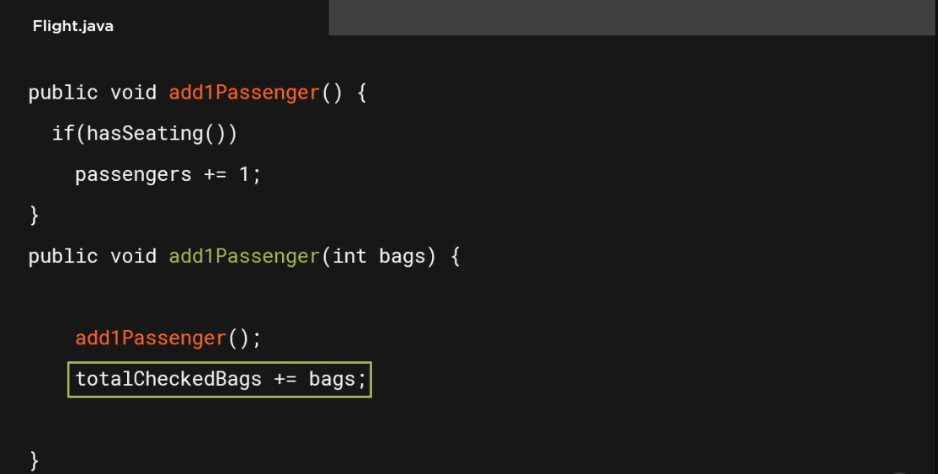

Slide 25
public void add1Passenger() {
if(hasSeating())
Flight.java
passengers += 1;
}
public void add1Passenger(int bags) { if(hasSeating()) {
add1Passenger(); totalCheckedBags += bags;
}
}

Slide 26
public void add1Passenger(Passenger p) {
add1Passenger(p.getCheckedBags());
Flight.java
}
public void add1Passenger(int bags, int carryOns) { if(carryOns <= 2)
add1Passenger(bags);
}
public void add1Passenger(Passenger p, int carryOns) { add1Passenger(p.getCheckedBags(), carryOns);
}

Slide 27
Overloading
Main.java
Flight f = new Flight();
f.add1Passenger();
Flight.java
add1Passenger()
add1Passenger(int bags) add1Passenger(Passenger p) add1Passenger(int bags,
int carryOns)
add1Passenger(Passenger p,
int carryOns)

Slide 28
Overloading
Main.java
Flight f = new Flight();
f.add1Passenger(); f.add1Passenger(2);
Flight.java
add1Passenger()
add1Passenger(int bags)
add1Passenger(Passenger p)
add1Passenger(int bags,
int carryOns)
add1Passenger(Passenger p,
int carryOns)

Slide 29
Overloading
Main.java
Flight f = new Flight();
f.add1Passenger(); f.add1Passenger(2);
Passenger p1 =
new Passenger(0, 1);
f.add1Passenger(p1);
Flight.java
add1Passenger()
add1Passenger(int bags)
add1Passenger(Passenger p)
add1Passenger(int bags,
int carryOns)
add1Passenger(Passenger p,
int carryOns)

Slide 30
Overloading
Main.java
Flight f = new Flight(); Passenger p2 =
new Passenger(0, 2);
f.add1Passenger(p2, 1);
Flight.java
add1Passenger()
add1Passenger(int bags)
add1Passenger(Passenger p)
add1Passenger(int bags,
int carryOns)
add1Passenger(Passenger p,
int carryOns)

Slide 31
Overloading
Main.java
Flight f = new Flight(); Passenger p2 =
new Passenger(0, 2);
f.add1Passenger(p2, 1); short threeBags = 3;
f.add1Passenger(threeBags, 2);
Flight.java
add1Passenger()
add1Passenger(int bags)
add1Passenger(Passenger p)
add1Passenger(int bags,
int carryOns)
add1Passenger(Passenger p,
int carryOns)

Slide 32
public void addPassengers(Passenger[] list) {
if (hasSeating(list.length)) {
Flight.java
passengers += list.length;
for (Passenger passenger : list) totalCheckedBags += passenger.getCheckedBags();
}
}
private boolean hasSeating(int count) { return passengers + count <= seats;
}

Slide 33
Flight f = new Flight();
Main.java
Passenger luisa = new Passenger(0, 1);
Passenger john = new Passenger(0, 2); f.addPassengers(new Passenger[] {luisa, john});
Passenger harish = new Passenger(0, 2); Passenger julie = new Passenger(0, 2); Passenger ashanti = new Passenger(0, 0);
f.addPassengers(new Passenger[] {harish, julie, ashanti});

Slide 34
public void addPassengers(Passenger[] list)
Variable Length Parameter Lists
A method can be declared to accept a varying number of parameter values
- Place an ellipse after parameter type

Slide 35
public void addPassengers(Passenger... list)
Variable Length Parameter Lists
A method can be declared to accept a varying number of parameter values
Place an ellipse after parameter type
Can only be the last parameter
Method receives values as an array

Slide 36
public void addPassengers(Passenger... list) {
if (hasSeating(list.length)) { passengers += list.length;
for (Passenger passenger : list) totalCheckedBags += passenger.getCheckedBags();
}
}

Slide 37
Flight f = new Flight();
Main.java
Passenger luisa = new Passenger(0, 1);
Passenger john = new Passenger(0, 2); f.addPassengers(new Passenger[] {luisa, john});
Passenger harish = new Passenger(0, 2); Passenger julie = new Passenger(0, 2); Passenger ashanti = new Passenger(0, 0);
f.addPassengers(new Passenger[] {harish, julie, ashanti});

Slide 38
Flight f = new Flight();
Main.java
Passenger luisa = new Passenger(0, 1);
Passenger john = new Passenger(0, 2); f.addPassengers(luisa, john);
Passenger harish = new Passenger(0, 2); Passenger julie = new Passenger(0, 2); Passenger ashanti = new Passenger(0, 0);
f.addPassengers(new Passenger[] {harish, julie, ashanti});

Slide 39
Flight f = new Flight();
Main.java
Passenger luisa = new Passenger(0, 1);
Passenger john = new Passenger(0, 2); f.addPassengers(luisa, john);
Passenger harish = new Passenger(0, 2); Passenger julie = new Passenger(0, 2); Passenger ashanti = new Passenger(0, 0); f.addPassengers(harish, julie, ashanti);

Slide 40
Objects are passed by-reference
- Reference is copied to the method
Summary
Method changes to the reference
Not visible outside of the method
Method changes to referenced object
Remain visible outside of the method

Slide 41
Overloading
Multiple versions of a method or constructor within a class
Each must have a unique signature
Summary
Parts of the signature
Method name
Number of parameters
Type of each parameter

Slide 42
Summary
Variable length parameter lists
Place ellipse after parameter type
Must be last parameter
Method receives as an array

